Slide 1
Fiber Optics
Muhammad Taqui
01-136221-021

Slide 2
What are Fiber Optics?
Fiber optics (optical fibers) are long, thin strands of very pure glass about the diameter of human hair. They are arranged in bundles called optical cables and are used to transmit light signals over long distances.

Slide 3
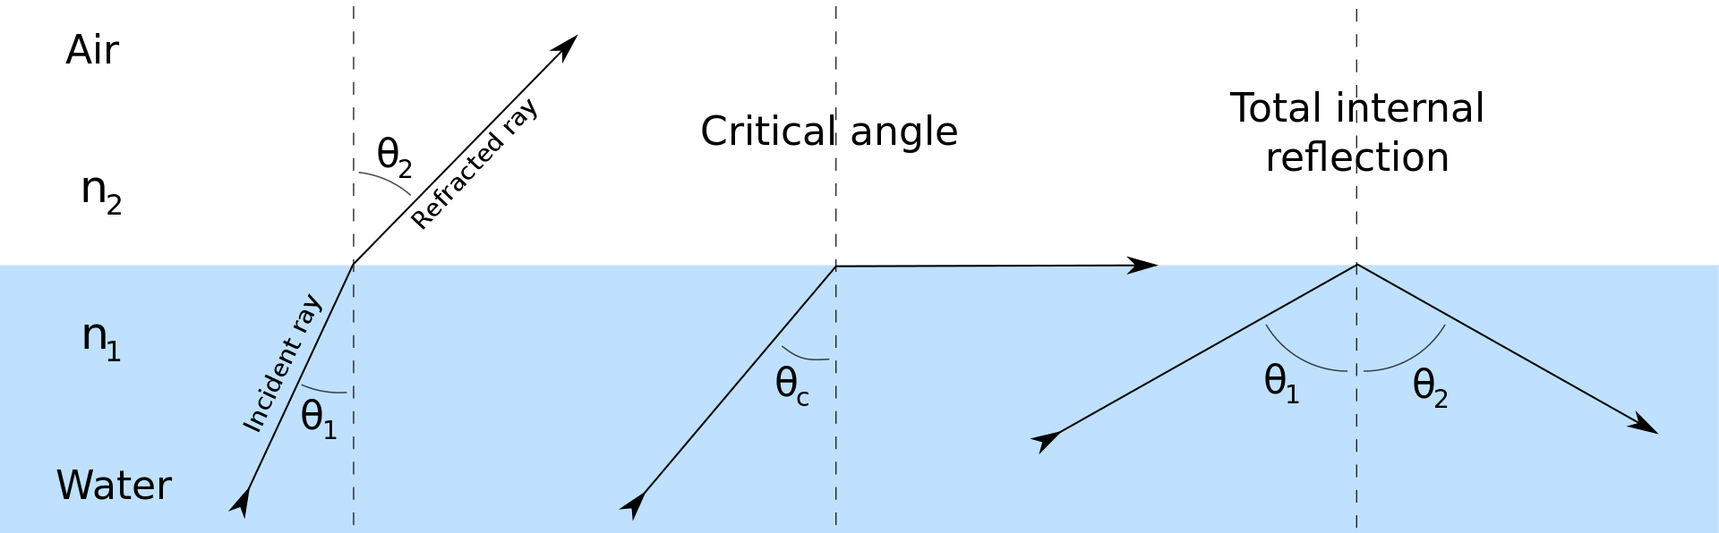
The Principle Behind Fiber Optics
Optical fiber works on the principle of total internal reflection. When light travelling in an optically dense medium hits a boundary at a steep angle (larger than the critical angle for the boundary), the light is completely reflected. This is called total internal reflection. This effect is used in optical fibres to confine light in the core. Light travels through the fibre core, bouncing back and forth off the boundary between the core and cladding. Because the light must strike the boundary with an angle greater than the critical angle, the only light that enters the fibre within a certain range of angles can travel down the fibre without leaking out.

Slide 4
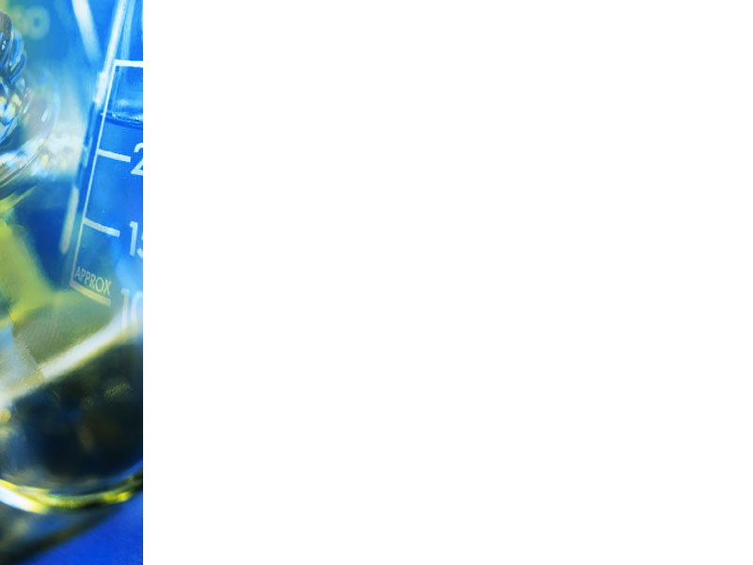
Structure of an Optical fiber
Poly urethane protective jacket
Cladding
Core

Slide 5
Optical fiber consists of three sections
Core: It is an inner cylindrical material made up of glass or plastic.
Cladding: It is a cylindrical shell of glass or plastic material in which the Core is inserted.
Protective Jacket: The Cladding is enclosed in a polyurethane jacket and it protects the fiber from surroundings.

Slide 6
TYPES OF OPTICAL FIBRES
Based on the variation of RI of the core, the optical fibers are mainly classified into the following types. i.e.,
Step Index Fiber
Gradex Index fiber
NOTE: Based on the Mode of propagation, the fibers are further divided into Single Mode and Multi Mode.

Slide 7
Single Mode Step Index fiber
The RI is constant for the core in this fiber. As we go radically from center of the core, the RI undergoes a step change at core-cladding interface .
The core diameter of this fiber is about 8 to 10µm and the outer diameter of cladding is 60 to 70µm.
There is only one path for light ray propagation. Hence it is called single mode step index fiber.
It is a reflective fiber since light is transmitted from one end to the other end of a fiber by TIR.
These are extensively used because distortion and transmission losses are very less.

Slide 8
Multimode Step Index Fiber
The construction of this fiber is similar to Single mode step index fiber but dimensions of Core and Cladding are much larger to have more number of paths for light propagation.
The Core diameter varies from 50 to 200µm and the Cladding diameter varies from 100 to 250µm.
It is also a reflective fiber since light is propagated in the form of multiple TIRS.

Slide 9
GRADED INDEX FIBRE
In this fiber , Radially the RI of Core continuously decreases from center to the surface.
The RI is maximum at the center of Core and Minimum at the Surface.
This fiber can be a single mode or Multimode ,the diameters of core and cladding varies from 50-200µm and 100-250µm respectively.

Slide 10
Uses of Fiber Optic Cables
Internet
Cable Television
Telephone
Lighting and Decorations
Surgery

Slide 11
Advantages of Optical Fiber
Cheap
Thinner and light-weighted
Higher carrying capacity
Less signal degradation
Long lifespan

Slide 12
Disadvantages of Optical Fiber
Low power
Light emitting sources are limited to low power.
Fragility
Optical fiber is rather fragile and more vulnerable to damage compared to copper wires.
Distance
The distance between the transmitter and receiver should keep short or repeaters are needed to boost the signal.

Slide 13
Conclusion
Optical fiber provides a fast, constant and stable Internet connection that allows a lot of data to be transmitted over incredible distances. As data demands become enormous, fiber optic cabling is the sure way to go for network flexibility and stability.

Slide 14


